Slide 1
Threat/Risk Modeling and Sharing
Overview
May 2014

Slide 2
Motivation
Threat information sharing critical enabler for ‘wire-speed’ defense of complex systems
Information sharing requires shared concepts for across domains
NIEM is used by US federal, state, and local government, as well as internationally
STIX is being adopted by a large number of users for Cyber
Snort rules are common for IDS
Multiple protocols, languages, and models used throughout industry today, but:
Re-use of existing protocols for threat exchange (e.g. IODef)
Focus on threat indicators/signature and classification (e.g. STIX, OpenIOC)
Desire to have traceability from indicators to threat actors and their motivation/intent across multiple domains
Leverage existing work performed by social modeling and behavior groups, e.g. SI*
Integrate Physical, Cyber, Spectrum and other kinds of risks and threats
Some integration with other enterprise systems, but no comprehensive approach

Slide 3
Sponsorship
Object Management Group (OMG) Government, Systems Assurance, Business Modeling & Integration Task Forces
PM-ISE
Demandware (Gerald Beuchelt)

Slide 4

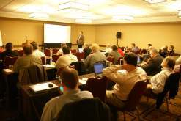
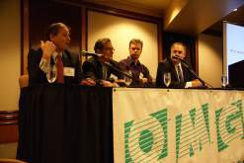
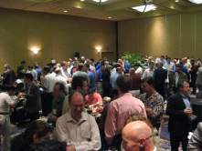
Who Is OMG?
Object Management Group (OMG):
Founded in 1989
More than 470 member companies
The largest and longest standing not-for-profit, open-membership consortium which develops and maintains computer industry specifications.
Continuously evolving to remain current while retaining a position of thought leadership.
Notes:
Which are membership requests, submits, develops and maintains To help achieve the objectives of Reusability, interoperability and portability
These standards are requested, submitted, adopted and maintained by the membership.

Slide 5




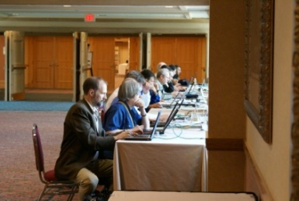
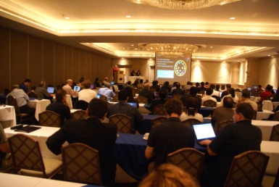
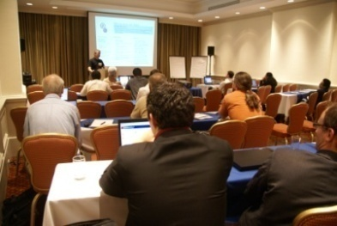
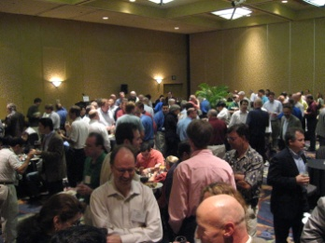
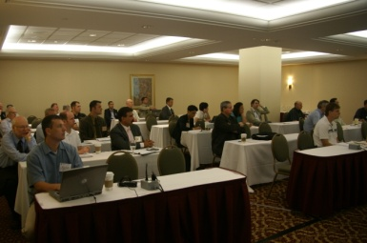
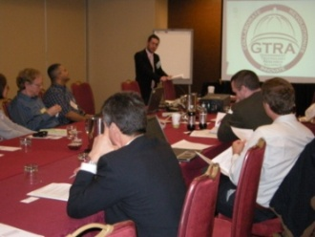
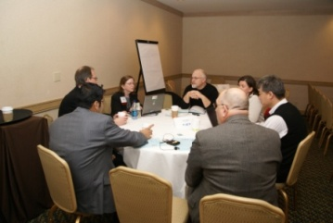
Developing Standards
Standards are developed using OMG’s mature, worldwide, open development process. With over 20 years of standards work, OMG’s one-organization, one-vote policy ensures that every vendor and end-user, large and small, has an effective voice in the process.
Notes:
5

Slide 6
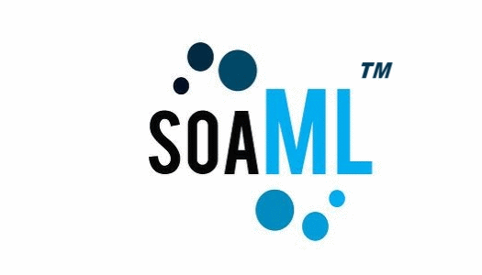







OMG’s Best-Known Successes
Common Object Request Broker Architecture
CORBA® remains the only language- and platform-neutral interoperability standard
Unified Modeling Language
UML® remains the world’s only standardized modeling language
Business Process Modeling Notation
BPMNTM provides businesses with the capability of understanding their internal business procedures
Common Warehouse Metamodel
CWMTM, the integration of the last two data warehousing initiatives
Meta-Object Facility
MOFTM, the repository standard
XML Metadata Interchange
XMI®, the XML-UML standard
SoaML
Service Oriented Modeling Language

Slide 7
Status
Threat Modeling project kicked off in Dec 2013
Multi-phase approach
Initially: create Cyber Domain PIM and STIX PSM with UML Profile for NIEM
Expand to non-cyber domains and inclusion of risk
Evolution of thinking
Team moves to a conceptual modeling approach covering situational awareness across multiple kinds of threats and risks (not just Cyber)
Identification of use cases (documented on GITHUB site)
Progress so far
Provided preliminary UML version of STIX, identified STIX primary concepts
Developed initial conceptual threat model
Some basic mappings from NIEM to STIX by ‘pivoting’ through conceptual model
Next steps
Expand conceptual model and solidify NIEM and STIX mappings
Identify additional information domains/sharing stacks for mapping
Explore additional use cases (including modeling and predictive analysis)
Integration with Risk Meta Model
Issue OMG-RFP
There are scope and “business case” directions being set as the team has evolved

Slide 8
Use Case: Large Company
Company with multiple datacenters, office facilities, international business activity
Large number of deployed security systems, sensors
Firewalls, IDS/IPS, SIEM, monitoring systems, notification/alerting, etc.
Uses FW/Snort rules, STIX/TAXII, IODef, alarms for fire and intrusions, etc.
Physical and information security staff, some 24/7
Interoperable (but not uniform) threat monitoring and assessment

Slide 9
Use Case – Critical Infrastructure
Target: A group of organizations that collaboratively manage critical infrastructure and utilize Industrial Control Systems.
Power, water and other critical infrastructure are threatened by cyber and physical terrorism.
Industrial Control Systems are increasingly computer controlled and connected (directly or indirectly) to the internet and may embed compromised control hardware/software from questionable sources.

Slide 10
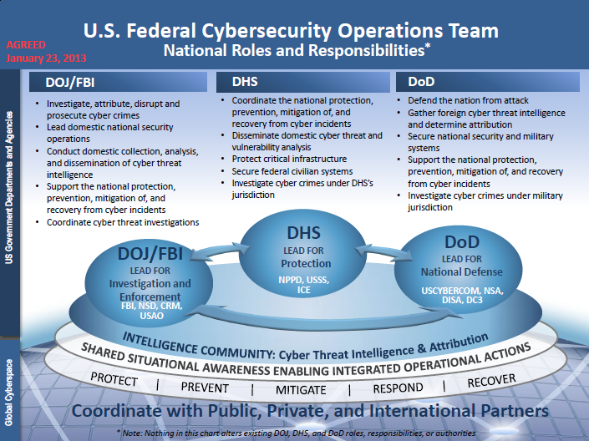
Use Case: National Roles and Responsibilities

Slide 11
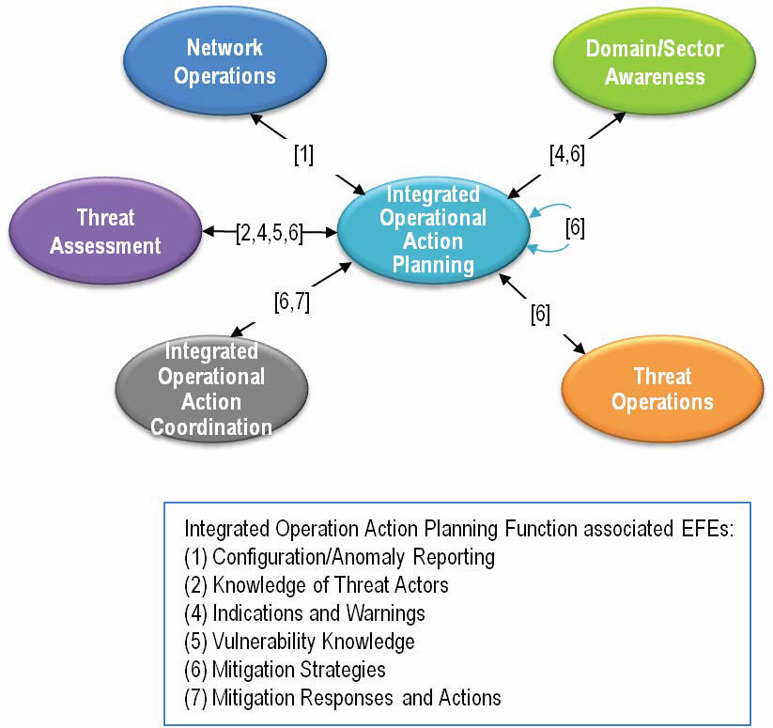
Use Case: IOA Planning Information Exchanges

Slide 12
Existing Interoperability No Common Meta Model
PT XML (notional)
Cap XML
Physical Threat Model
CAP (Model)
IODef (model)
Snort (model)
IODef (protocol)
STIX PIM
Snort rules
STIX XML
STIX JSON

Slide 13
Model for Semantic Interoperability Common Meta Model (Model 1)
Meta Model/Ontology
STIX RIM
IODef (model, implicit)
CAP (Model, implicit)
STIX XML
STIX JSON
IODef (protocol)
Cap XML
Snort (model, implicit)
Snort rules
Physical Threat Model
PT XML (notional)
Managed by OMG
Managed by Communities

Slide 14
Refining the Scope
At one end of the spectrum:
Cyber specific
STIX/Cybox, Full detail
At the other end:
Situational awareness for operational threats and risks in general, across domains
Input summary information from cyber, law enforcement, natural disasters, etc.
Team’s trend

Slide 15
Cross-domain operational threats and risks
Conceptual model covering threats & risks in general – Situational Awareness
Wide and shallow conceptual model
Map (Complete)
Map (Summary Concepts)
NIEM
Threat/Risk
Model
Map (Replicate Concepts)
Map ( Summary Concepts)
STIX/TAXII
Other Cyber Related
…
CYBOX
EDXL
CAP
Physical Related
…
Criminal
Related
…
Natural
Related
…
Spectrum
Related
…

Slide 16
Cross-Protocol/Conceptual Model
Benefits
Reduce number of point-to-point interoperability connections; reduce interoperability from N² to linear problem
Enable uniform semantic interoperability
Communities continue driving development of specific threat models
Can support (map between) multiple exchange formats: NIEM, STIX and others
The conceptual model does not commit to any one physical format
Disadvantages
Translations will be lossy
Communities need focus to define mappings from specific model to meta model

Slide 17
Operational Situational Awareness
Any
Threat/Risk
Situational
Awareness
Criminal
threats
Suspicious
Activity
Threat/Risk
Focus
Natural
threats
CAP
Physical
threats
A little extra for Cyber
STIX/TAXII
Leverages
STIX/Cybox
CYBOX
Cyber Only
Detail

Slide 18
Pivoting Through a Conceptual Model
“Source”
Data
Representation
Data representations (Schema & Instances)
Model data for a purpose using a technology
“Instances” are data structures (e.g. SQL tables or XML documents) – “facts” about the things in the world from some perspective
Conceptual Domain Models (CDM)
A conception of the world by a group of stakeholders – less purpose specific
“Instances” are things in the world – so can’t be in models
Using abstraction, we can have multiple representations of facts about the world in different data structures and technologies
Rules define how domain concepts can be represented in a particular form – rules can be simple and generic or heavyweight and specific, depending on the representation.
“Target”
Data
Representation
Represent
Rules
Conceptual Domain Models
(Models of the world)

Slide 19
Overview Models

Slide 20
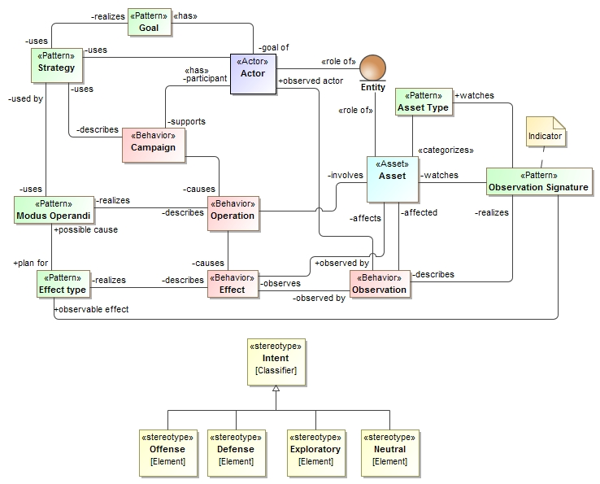
Current Conceptual Model Overview

Slide 21
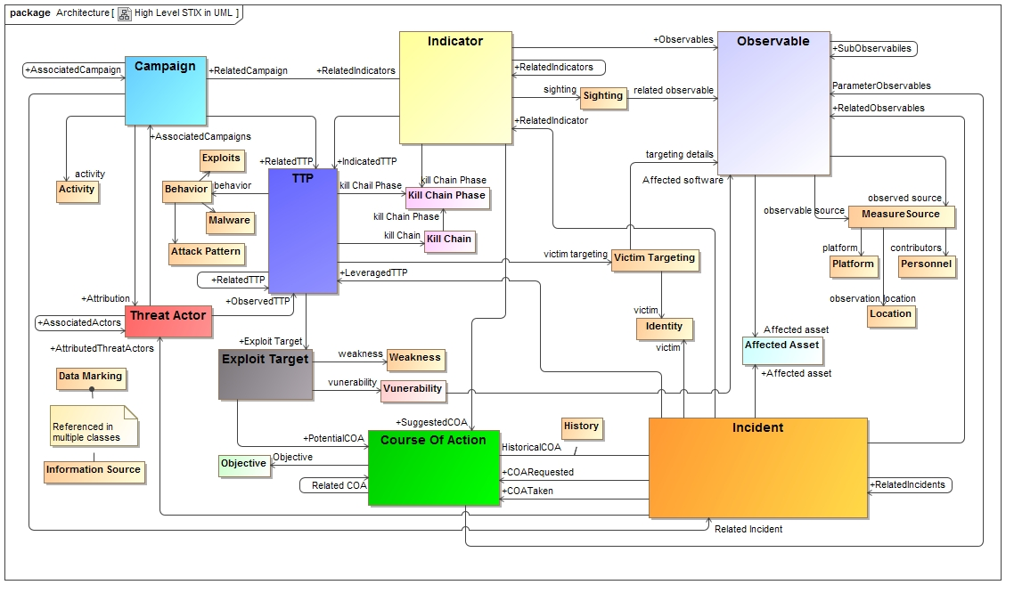
As-is STIX “Logical Level” in UML

Slide 22
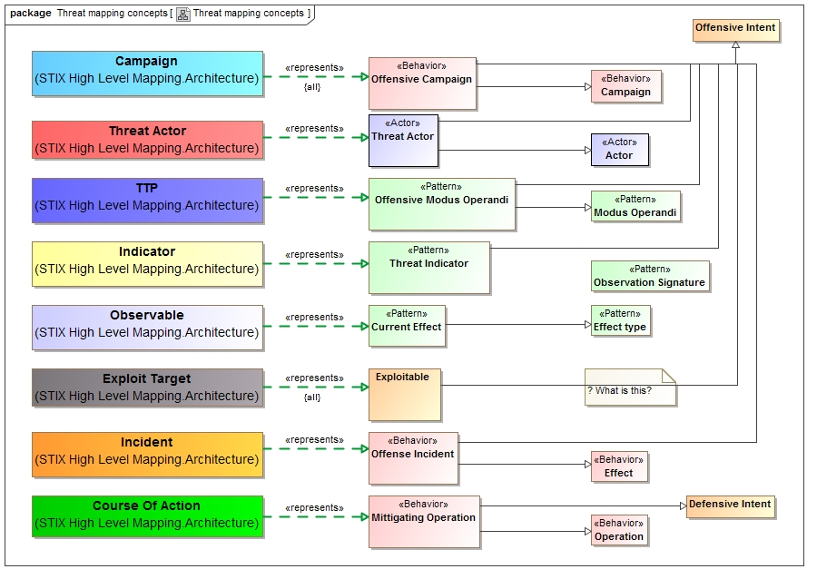
Mapping STIX and the conceptual Model

Slide 23
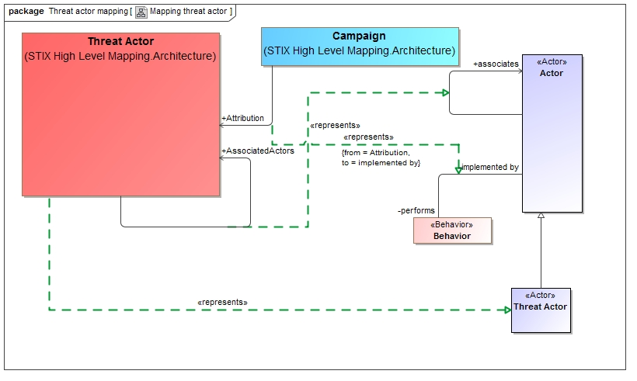
Example of lower level mapping

Slide 24
OMG RFP
Expected to be issued June 2014

Slide 25
RFP Objective
In the broadest sense, organizations manage operational threats and risks in order to provide a systematic response to uncertainties. Multiple communities have developed data and exchange schema and interfaces for sharing information about threats, risks and incidents that impact important government, commercial and personal assets and privacy. While each of these schema and interfaces provides value for a specific community it is difficult to federate these multiple representations to arrive at broad-based, planning, simulation, assessment, situational awareness, forensics and to then enact the appropriate courses of action. Cyber related attacks have added a new dimension that stresses traditional mitigation strategies.
This RFP calls for a conceptual model for operational threats and risks that unifies the semantics of and can provide a bridge across multiple threat and risk schema and interfaces. The conceptual model will be informed by high-level concepts as defined by the Cyber domain, existing NIEM domains and other applicable domains, but is not specific to those domains. This will enable combined Cyber, physical, criminal, spectrum and natural threats and risks to be federated, understood and responded to effectively.

Slide 26
OMG RFP Scope
Wide & shallow conceptual model covering threats and risks
Policy
Strategy & Planning
Operational & Execution Threats & Risk
High level Cyber-threat/risk concepts
Law Enforcement / Emergence Management Concepts
Normative
(Formal Specification)
Informative
NIEM Threat/Risk Representation
SACM
ISO
BMM
Others…
STIX/TAXII/Cybox
IODEF
ISO
NIST
Octave
Others…
NIEM Exchanges
EDXL / CAP
Financial – FIBO
Others

Slide 27
RFP Requirements
Conceptual Models
Operational Threat & Risk Concepts
Risk Assessment Concepts
Mitigation & courses of action
Risk & threat planning
NIEM representation & mapping
STIX/Cybox mapping
Common Requirements

Slide 28
RFP Non-Mandatory
Optional mappings
Optional support for conceptual modeling / mapping
Optional MOF representation

Slide 29
Backup

Slide 30
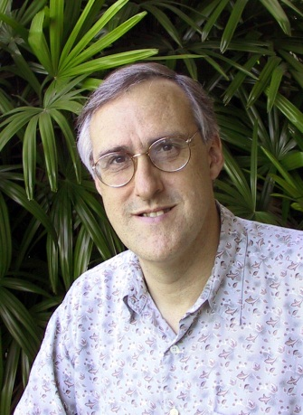
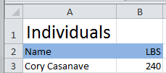

Example of “Pivoting” through a conceptual model
Concept of
“Cory Casanave”
There is an actual “Person”, Cory Casanave
There is a concept of this person shared in this room, right now
Here is one representation of him
“Person” is a shared concept, independent of data structures
There may also be shared agreement that Cory is a person and some other “facts”
“Cory Casanave” is a name for this person
He weighs 240 LBS
There are multiple data representations about Cory Casanave which may or may not agree
Those representations can be grounded in concepts (semantics), assisting federation
Concept of a
“Person”
<PersonType>
<NameText>Cory B. Casanave</NameText>
<Weight-LBS>234</Weight-LBS>
</PersonType>
XML
Representations
.
Excel
UML

